Slide 1
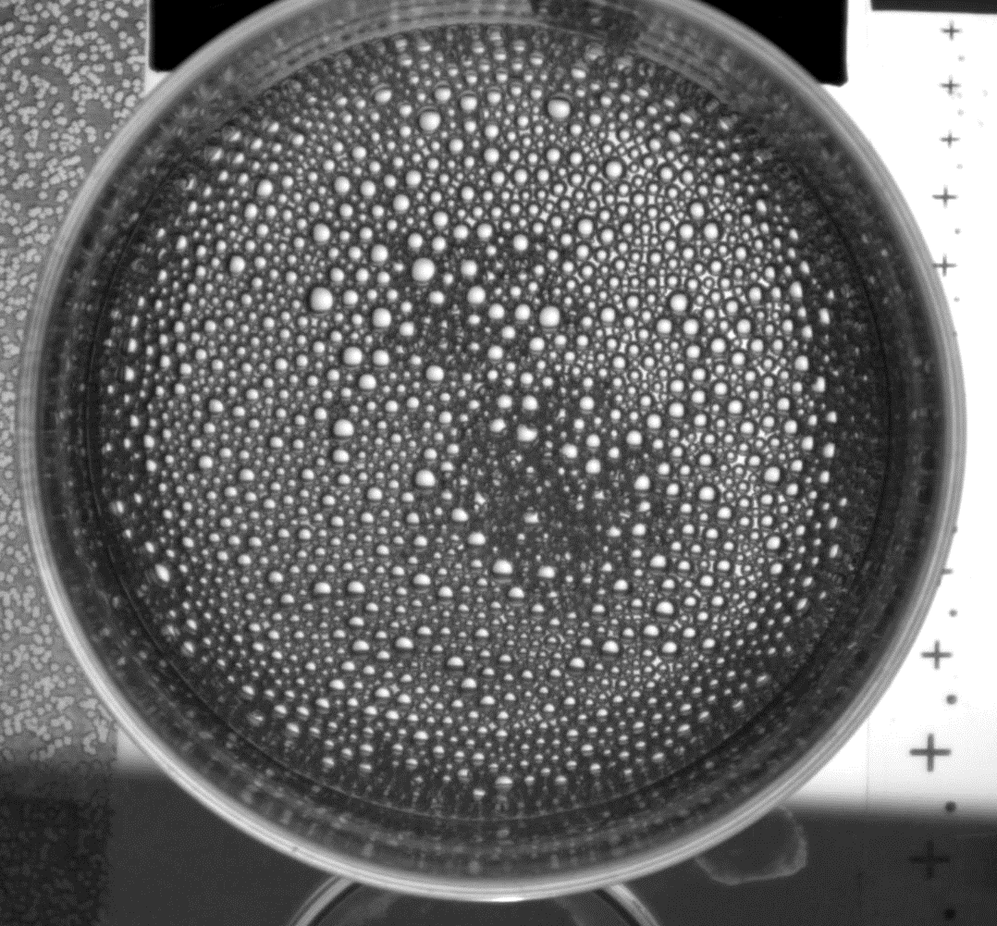
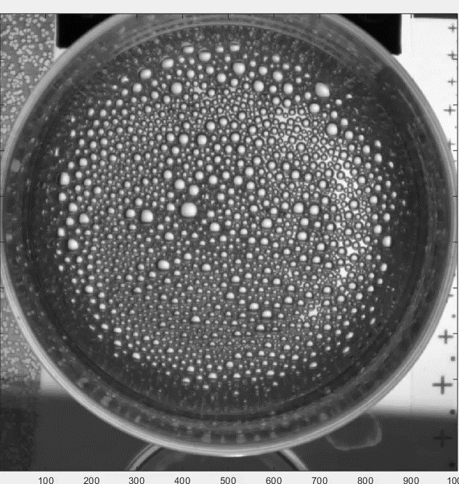
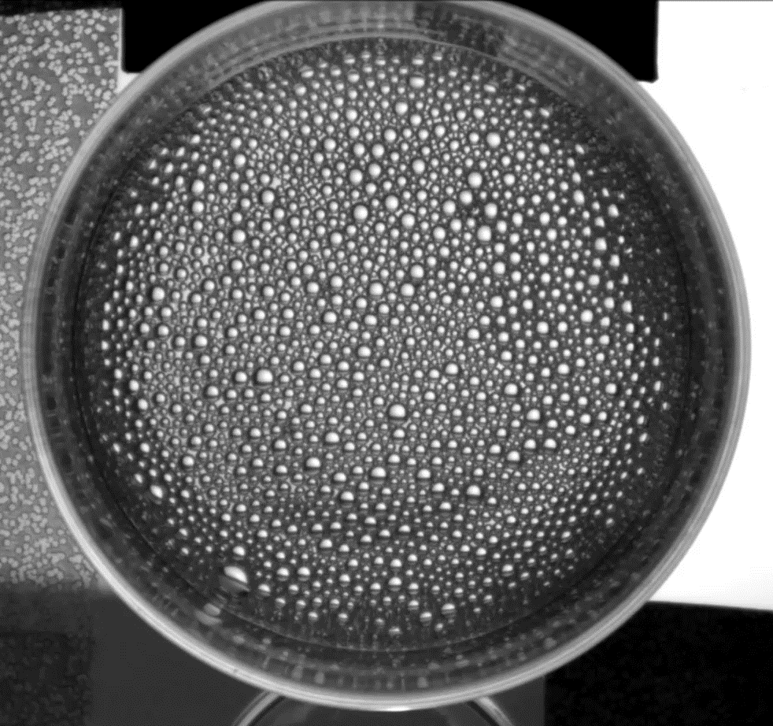
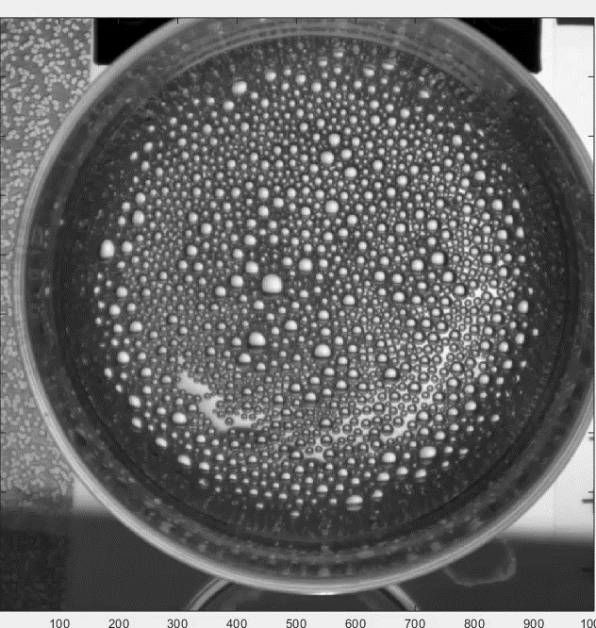
Strange rotation in an orbitally shaken glass of beer
Real time
Real time
Forcing
Phase
velocity
Stroboscopic
Stroboscopic

